Slide 1


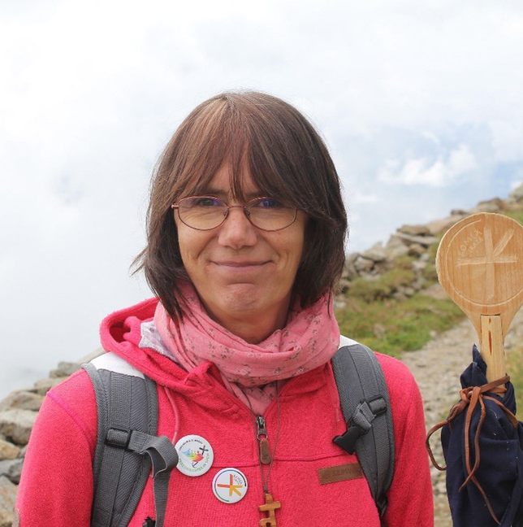
Strategic goals for the next five years
ROMEA STRATA AS A BRIDGE FOR INNOVATION
IN EUROPEAN CULTURAL TOURISM
SPEAKER
Christa ENGLINGER
Vice President of the Romea Strata European Association
Cultural Routes with Experiences
Bratislava – January 27, 2026

Slide 2

A HISTORICAL ROUTE
CONNECTING NORTHERN & CENTRAL EUROPE
Christa ENGLINGER
SPEAKER
Bridging cultures – chances and challenges
4.700 km
Vast variety of pilgrim ways, CULTURES, TRADITIONS, NATURAL treasures, EVENTS
ROMEA STRATA AS A BRIDGE FOR INNOVATION
IN EUROPEAN CULTURAL TOURISM
7 countries
Mutual cultural understanding
62 members
romeastrata.org

Slide 3

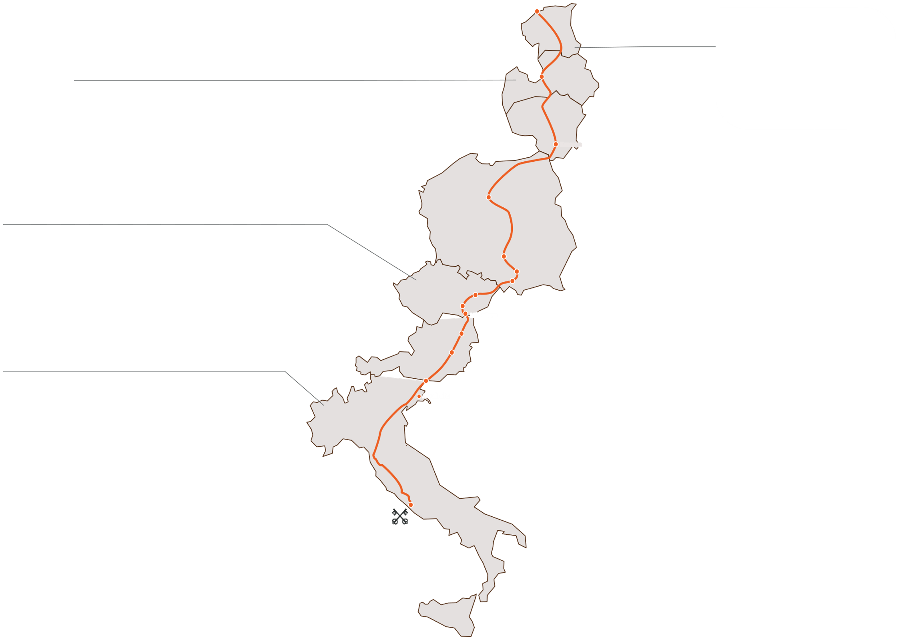
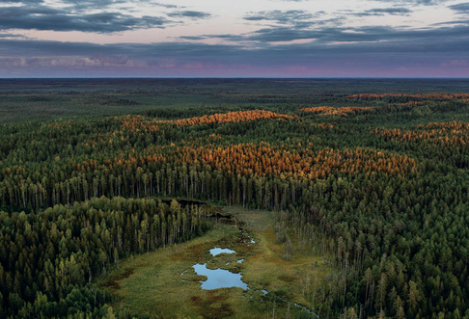
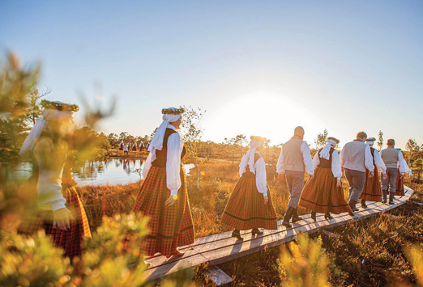
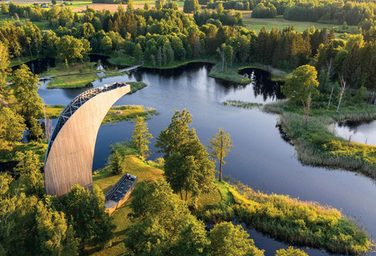
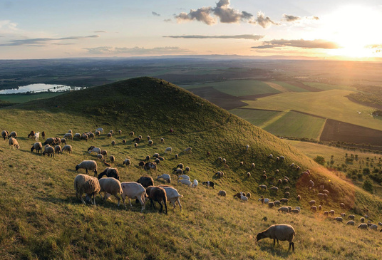
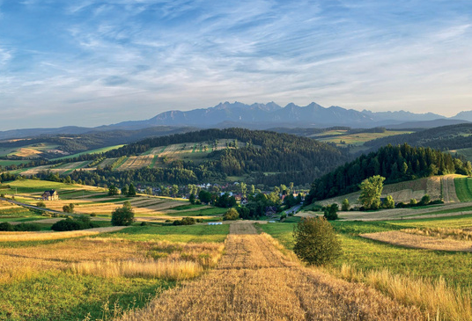
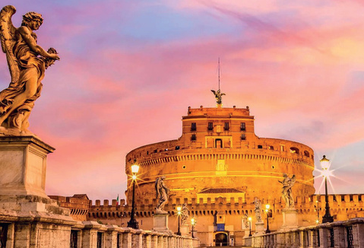
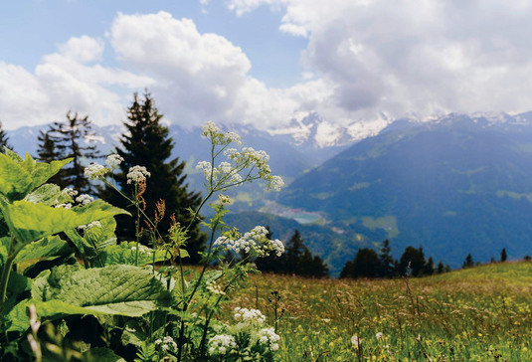
ESTONIA
FROM
TALLINN
LATVIA
Ryga
TO
VALGA
FROM
VALKA
KM
340
TO
SKAISTKALNE
STAGES
13
KM
425
Christa ENGLINGER
STAGES
18
Kaunas
SPEAKER
LITHUANIA
FROM
GERMANIŠKIS
Toruń
TO SEINAI
CZECH REP
KM 530 STAGES 23
FROM
WISLA
Częstochowa
TO
MIKULOV
Kraków
KM
380
STAGES
27
Brno
Wadowice
Mikulov
POLAND
ROMEA STRATA AS A BRIDGE FOR INNOVATION
IN EUROPEAN CULTURAL TOURISM
Wien
FROM
DUSZNICA
ITALY
Mariazell
TO
CIESZYN
KM
1.260 50
FROM
TARVISIO
Tarvisio
STAGES
TO
ROMA
Aquileia
KM
1.100
STAGES
82
AUSTRIA
Roma
FROM
MIKULOV
7
4700
TO
TARVISIO
km
KM 710
245
51
STAGES 32
COUNTRIES
WALKING STAGES
UNESCO SITES
OF MAPPED ROUTE
romeastrata.org

Slide 4
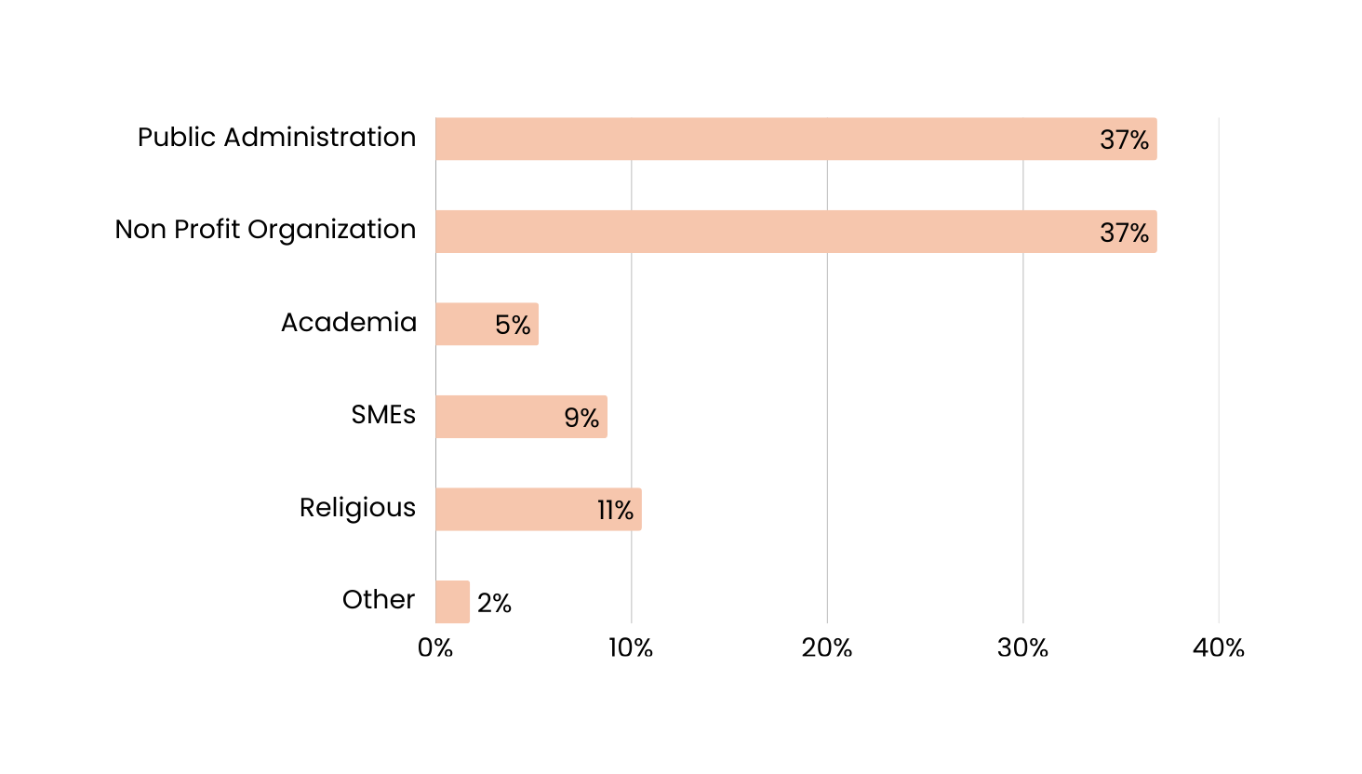
Christa ENGLINGER
A DIVERSE AND DYNAMIC NETWORK …
SPEAKER
… to activate the itinerary
62
ROMEA STRATA AS A BRIDGE FOR INNOVATION
IN EUROPEAN CULTURAL TOURISM
Members
romeastrata.org

Slide 5
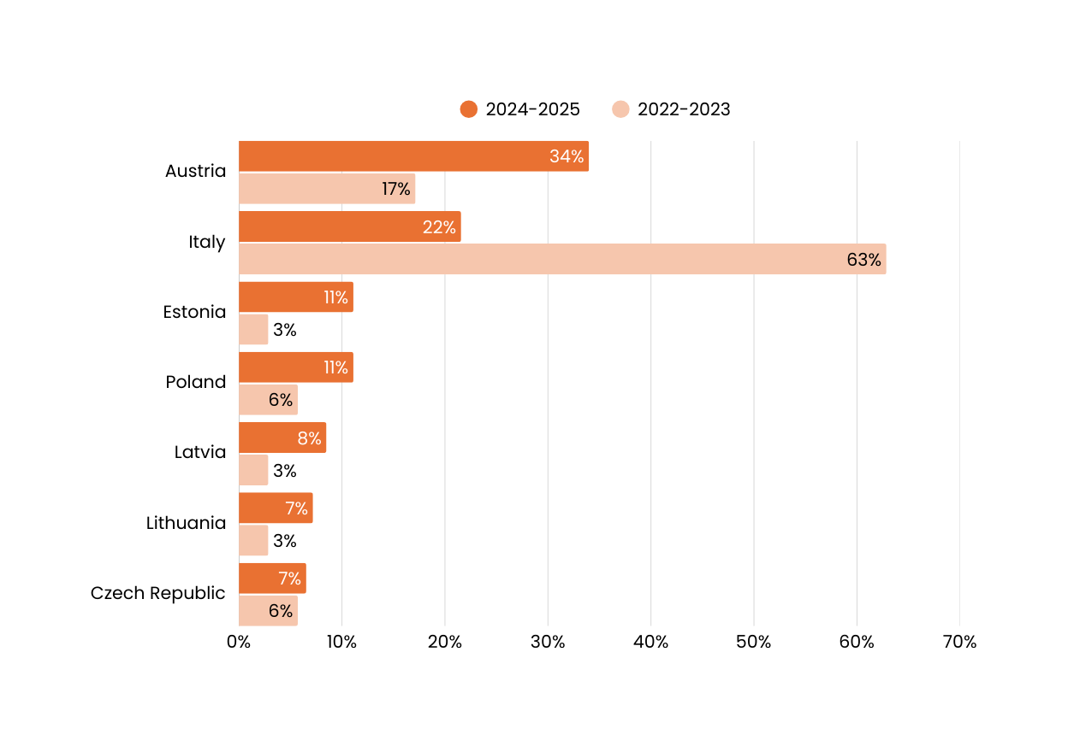
A VIBRANT
ITINERARY
Christa ENGLINGER
SPEAKER
Activities by country from 2022 to 2025
ROMEA STRATA AS A BRIDGE FOR INNOVATION
IN EUROPEAN CULTURAL TOURISM
romeastrata.org

Slide 6
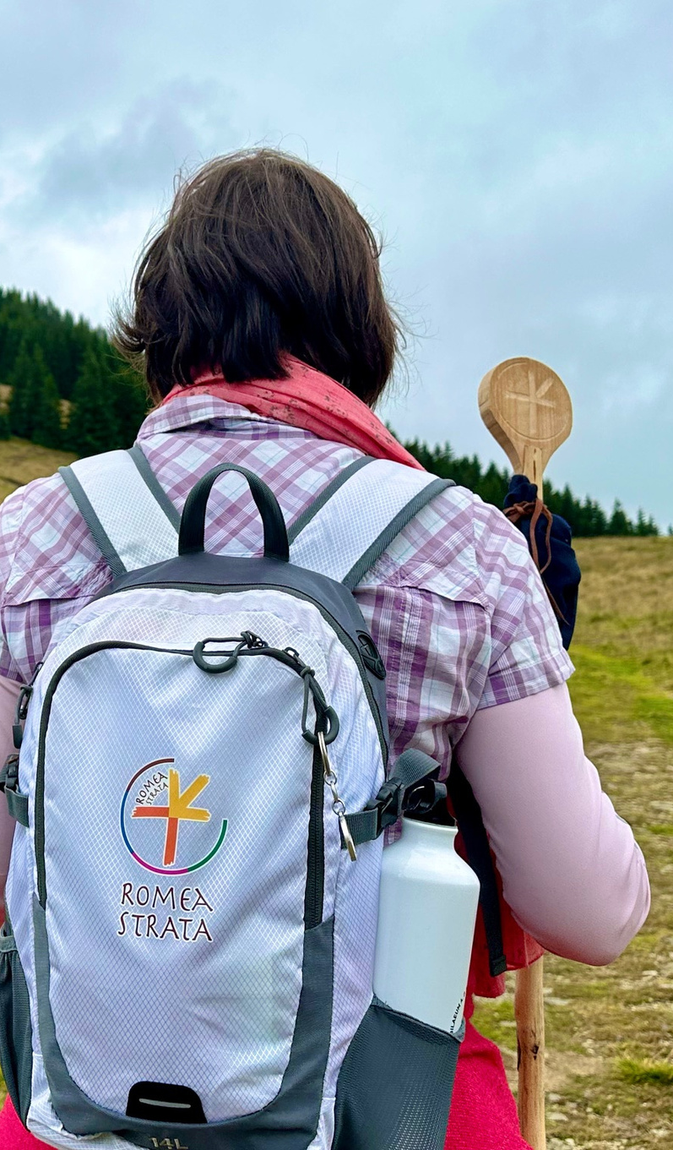
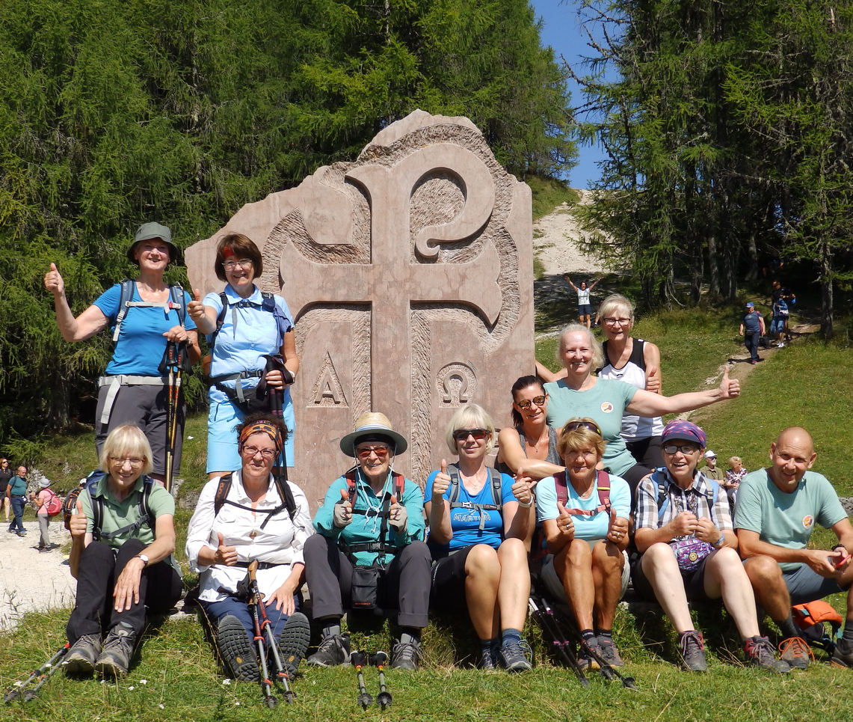
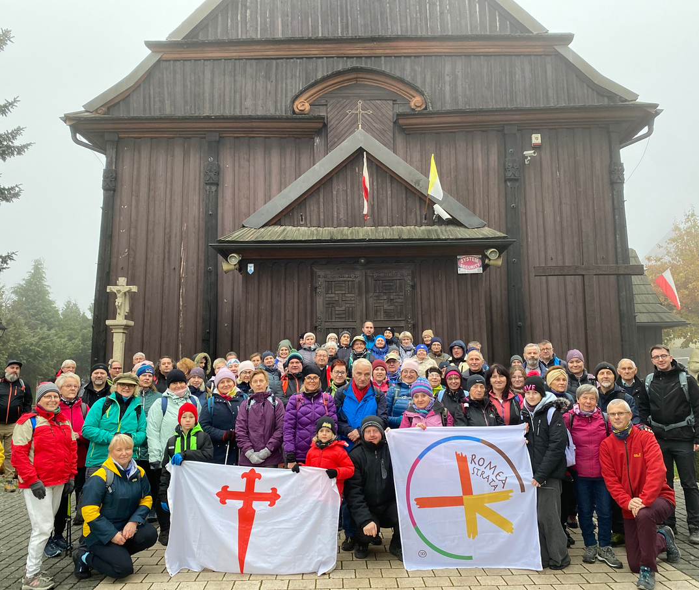
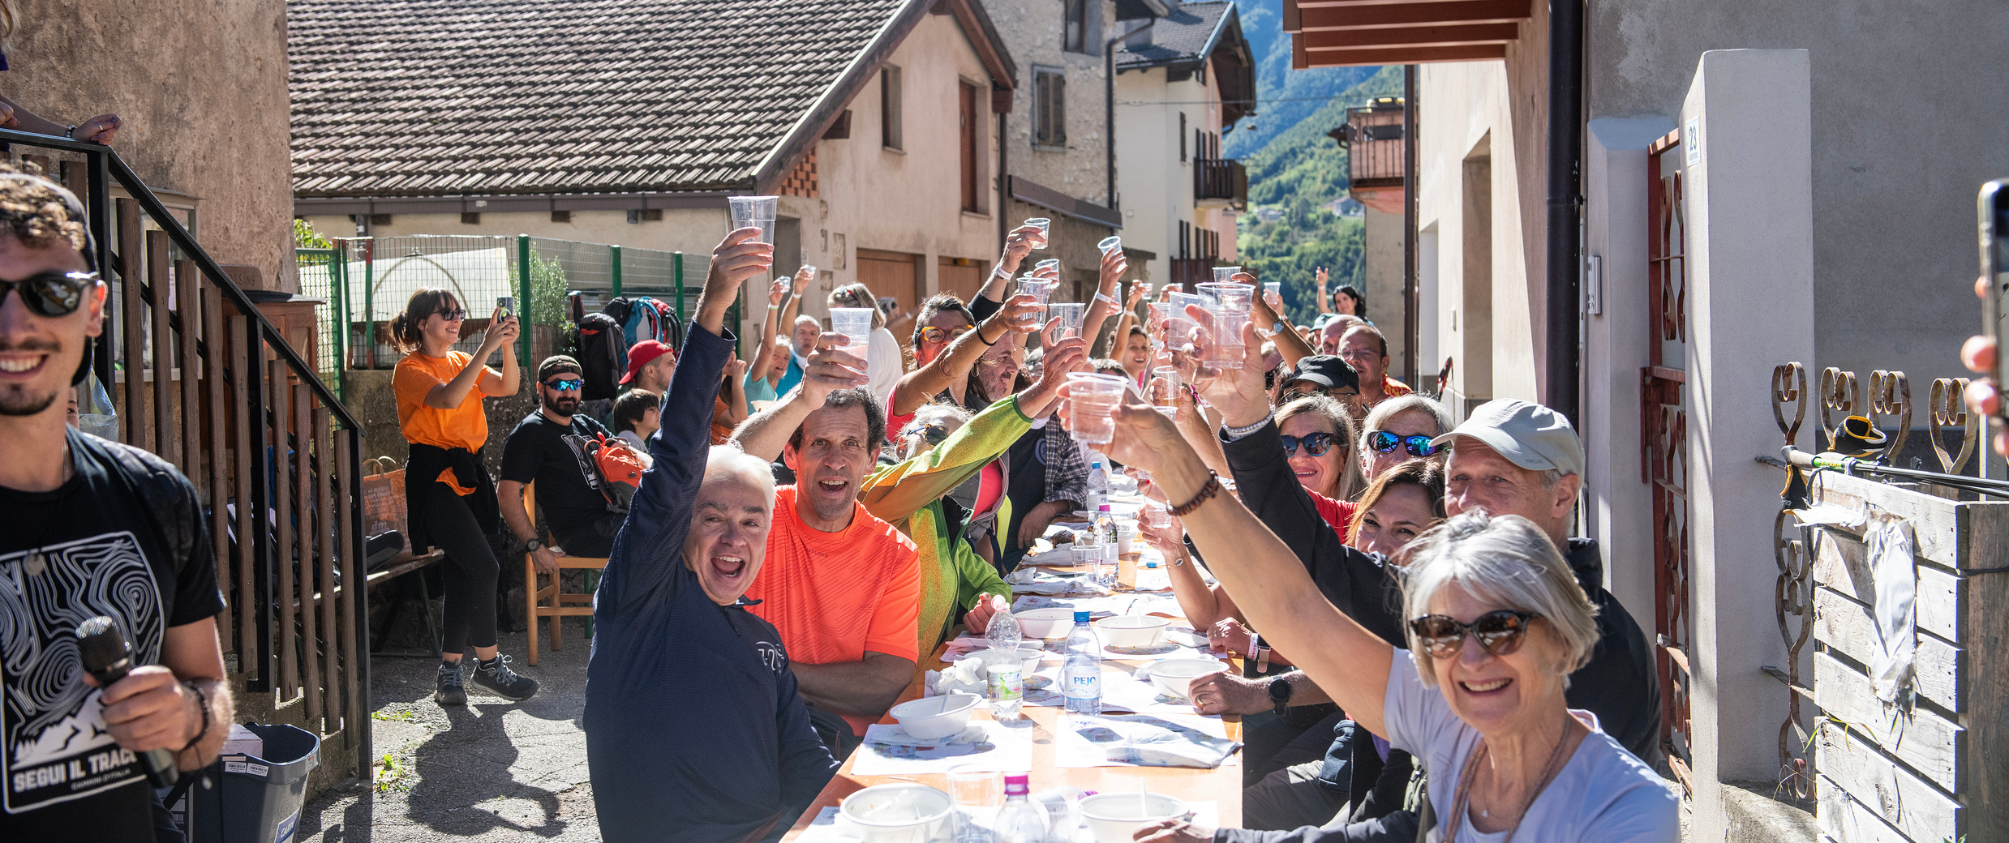

Slide 7
Christa ENGLINGER
A TOOL FOR SOCIOCULTURAL AND ECONOMIC REVITALIZATION
SPEAKER
The Romea Strata as a catalyst for sustainable growth.
ROMEA STRATA AS A BRIDGE FOR INNOVATION
IN EUROPEAN CULTURAL TOURISM
Protecting Local Identities
empower communities to be the primary beneficiaries of our development
Enhancing Rural and Inner Destinations
turn hidden gems into accessible cultural landmarks for all travelers
Promoting Sustainable Tourism
minimal environmental impact and genuine cultural experiences
romeastrata.org

Slide 8
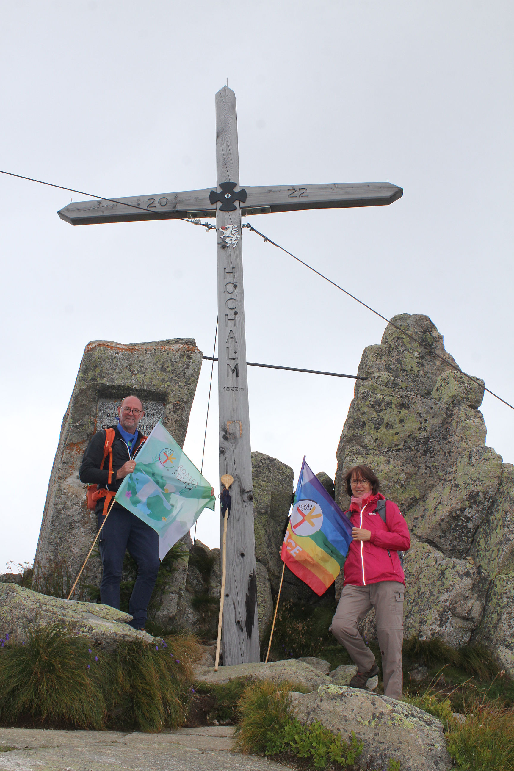
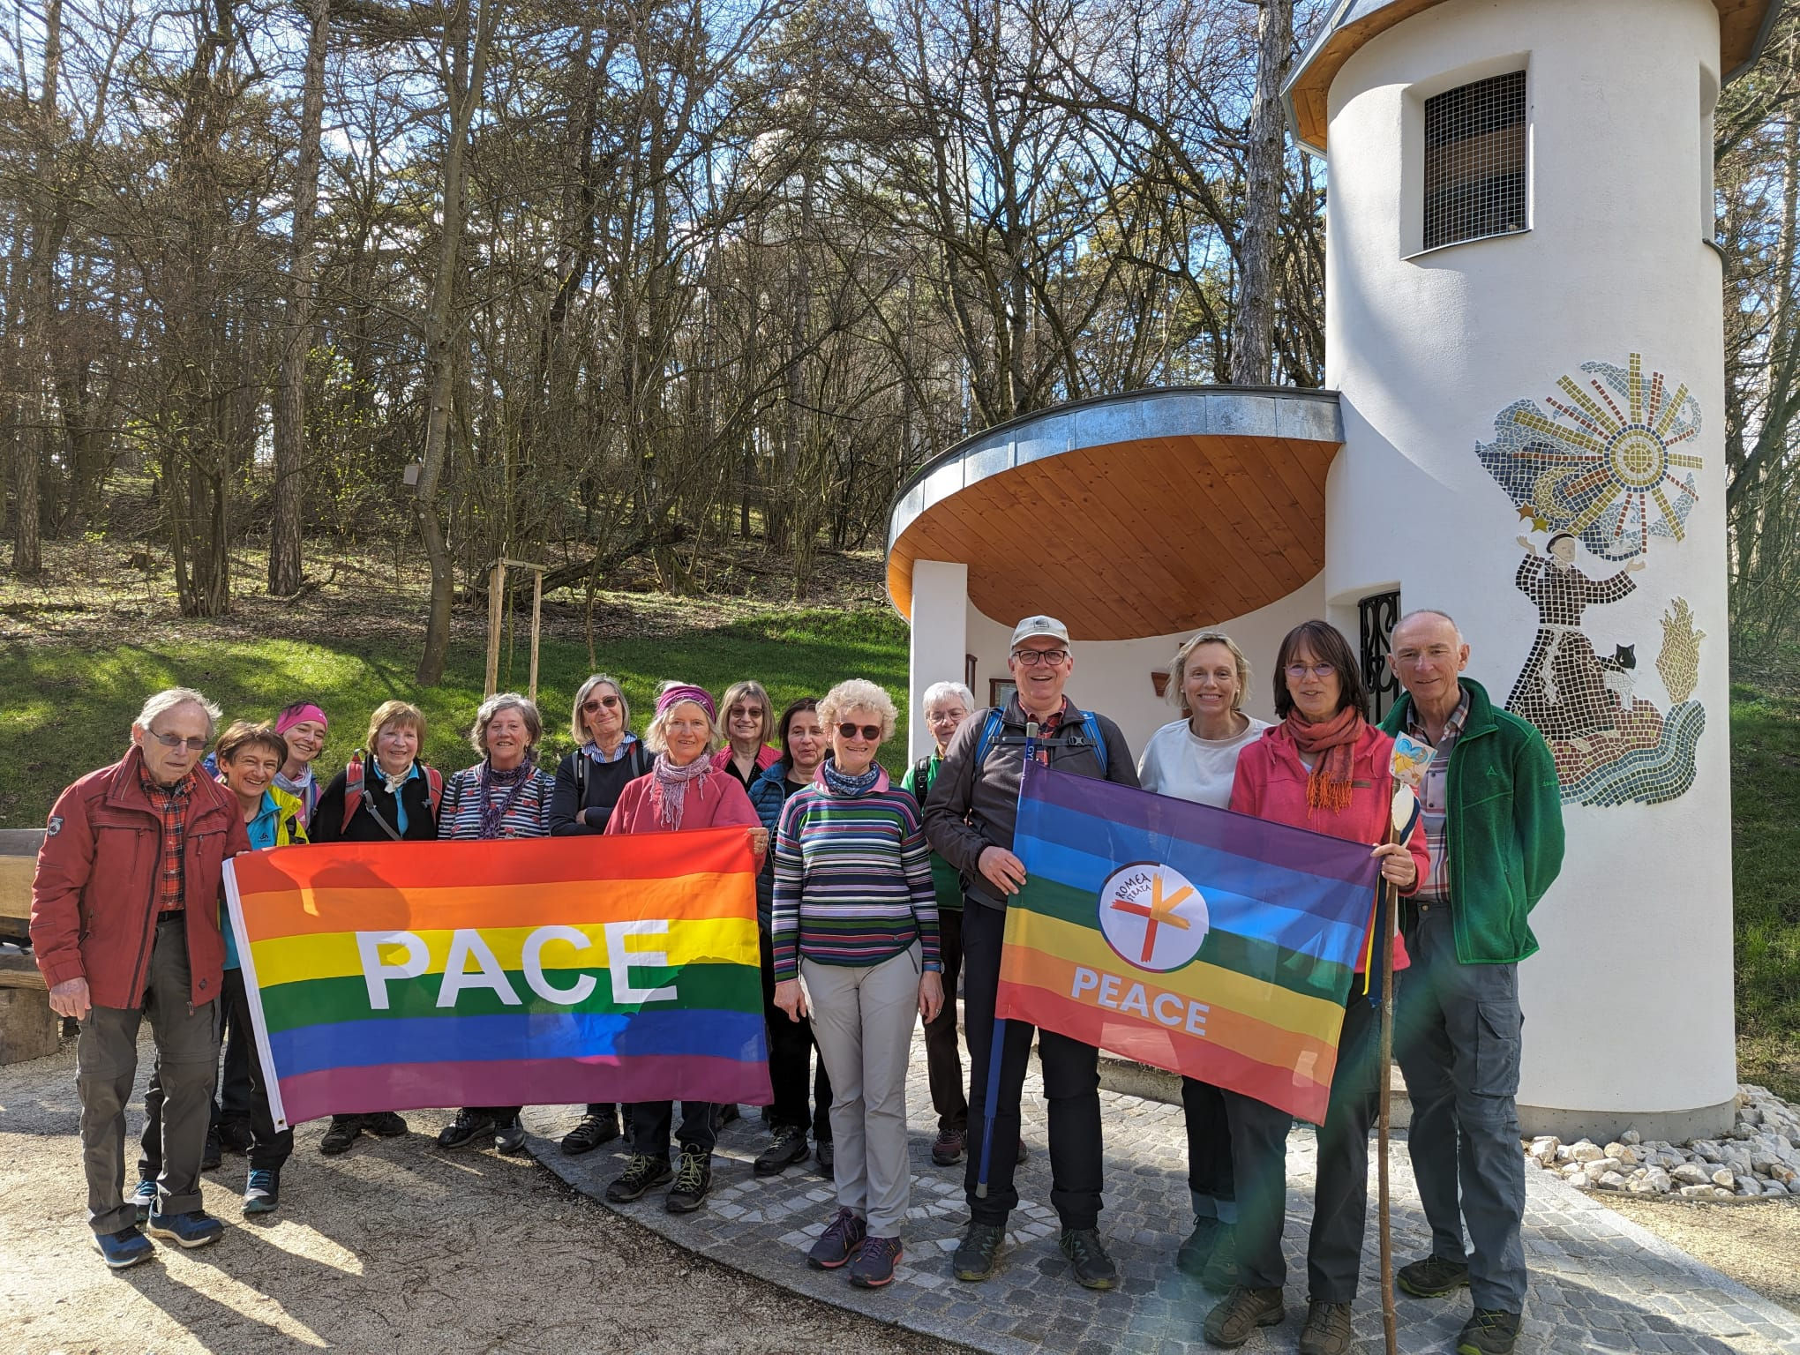
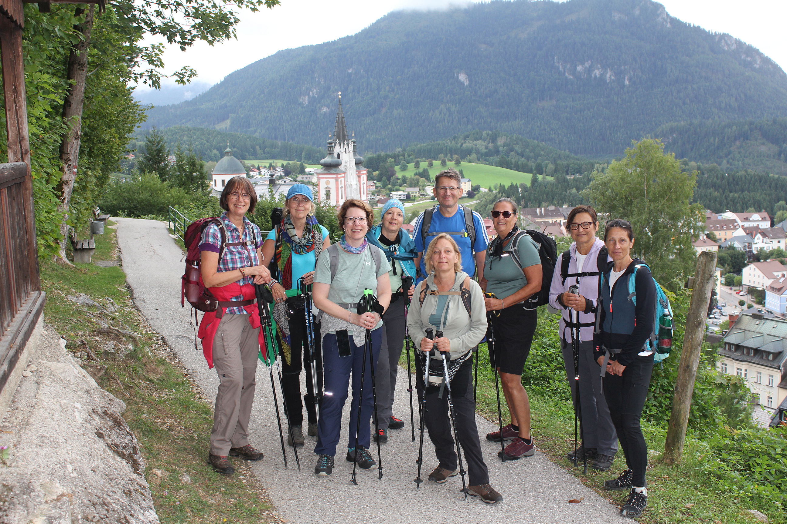

Slide 9
Christa ENGLINGER
NEXT STEPS
SPEAKER
How to reach our goals
1
3
5
Promoting
a closer unity
Create new common traditions
Promoting sustainable tour packages
ROMEA STRATA AS A BRIDGE FOR INNOVATION
IN EUROPEAN CULTURAL TOURISM
2
4
Reinforcing European cooperation
Guarantee constant development
romeastrata.org

Slide 10
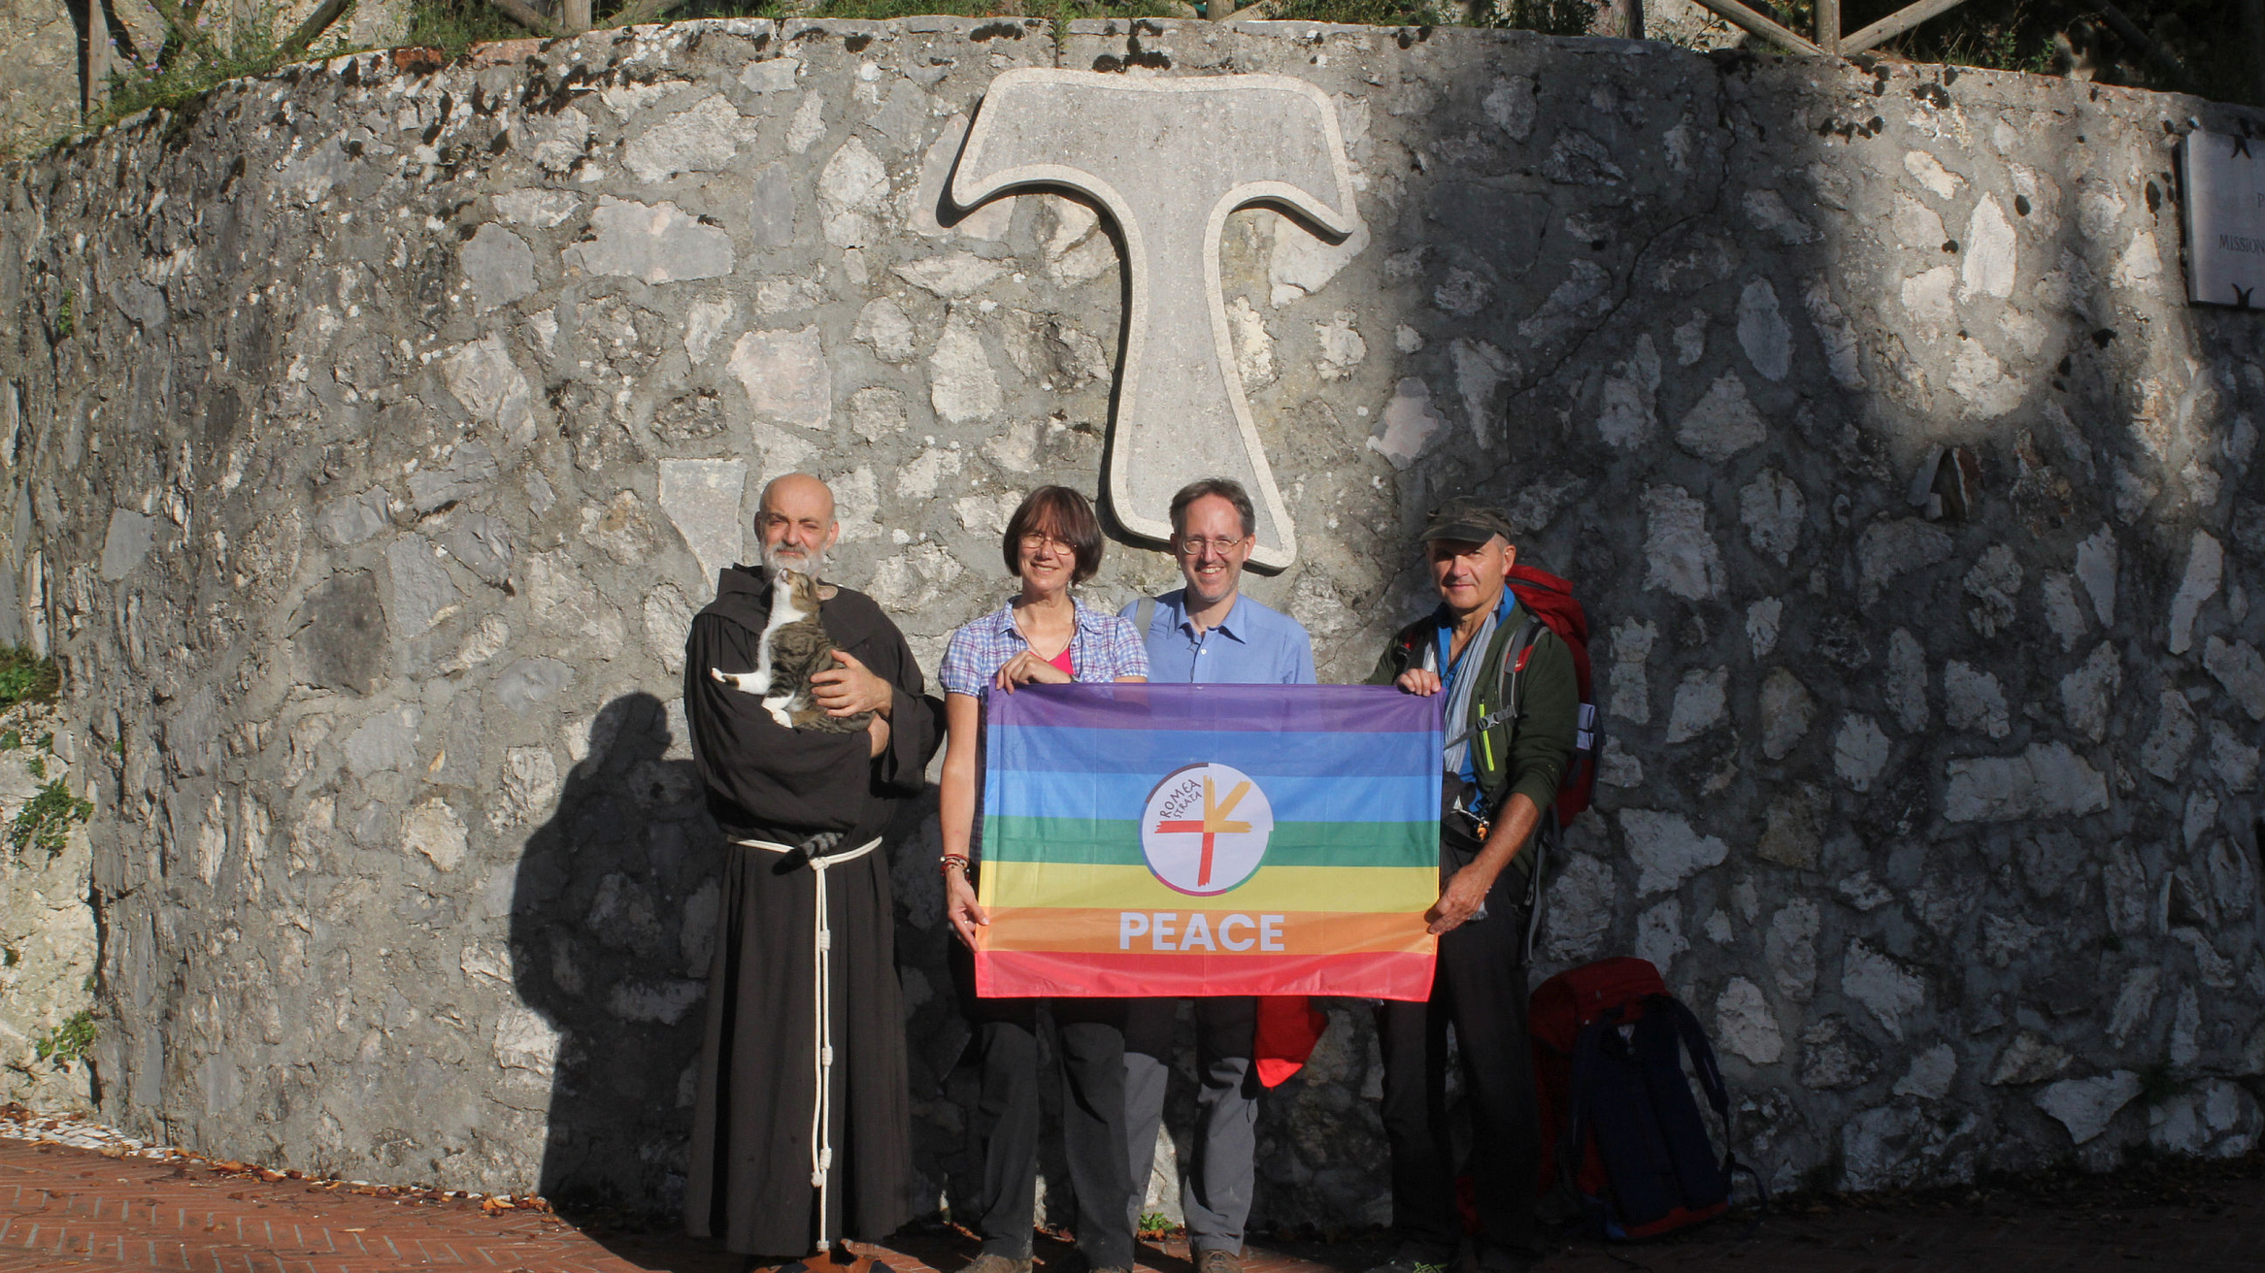

Slide 11
Strategic goals for the next five years
ROMEA STRATA AS A BRIDGE FOR INNOVATION
IN EUROPEAN CULTURAL TOURISM
SPEAKER
Christa ENGLINGER
Vice President of the Romea Strata European Association
Thank you!
romeastrata.org

